Slide 1
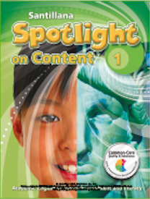
Santillana Spotlight on Content: Boosting Academic Vocabulary and Literacy Skills

Slide 2
What is Spotlight on Content?
Spotlight on Content is a supplemental ESL/ELD program that contains grade-appropriate informational texts from various content areas, including Science, Social Studies, and Math.
It also contains literary texts and literacy activities in its Language Arts lessons and provides extension and enrichment activities with music and art lessons.

Slide 3
What is Spotlight on Content?
Science, social studies, and math lessons are within Lexile-level ranges for the grade and increase in complexity gradually from one unit to the next, and from one grade to the next.
All lessons and components come with differentiated instruction, including activities for students of different proficiency levels as well as different modalities of learning.

Slide 4
What is Spotlight on Content?
All SOC booklets are pullouts of the Spotlight on Content section of Santillana Spotlight on English, which is a proven Standards-based program for English language learners designed to help K-5 students gain and develop English language proficiency, access grade-level content, and successfully transition to the mainstream classroom.

Slide 5
In a nutshell…

Slide 6
Who May Benefit from SOC?
Anyone looking for…
Literacy support
ESL/ELD support for content area classes
After-school programs for ESL/ELD
Summer school programs for ESL/ELD

Slide 7
Who May Benefit from SOE?
And who answers yes to these questions…
Are you looking for a solution that supports literacy instruction and builds academic vocabulary?
Do your ESL/ELD students need more support and practice reading grade-level appropriate informational texts?
Do your ESL/ELD students need reinforcement of content-area concepts, vocabulary, and structures?

Slide 8
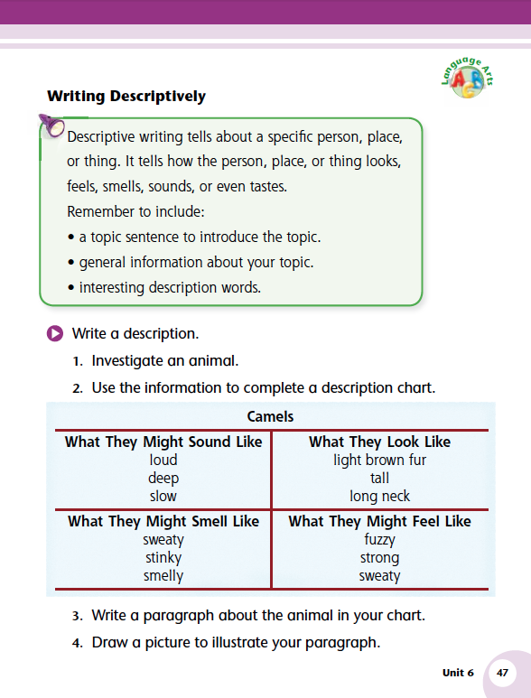
Let’s Look at the Program

Slide 9
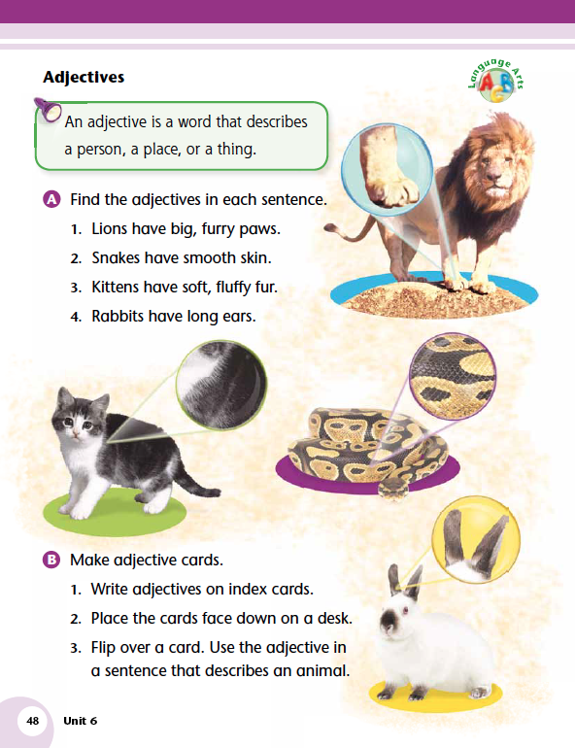
Let’s Look at the Program

Slide 10
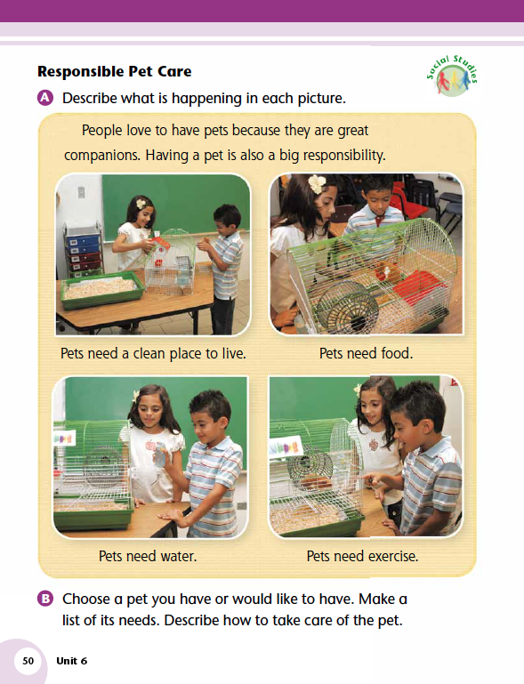
Let’s Look at the Program

Slide 11
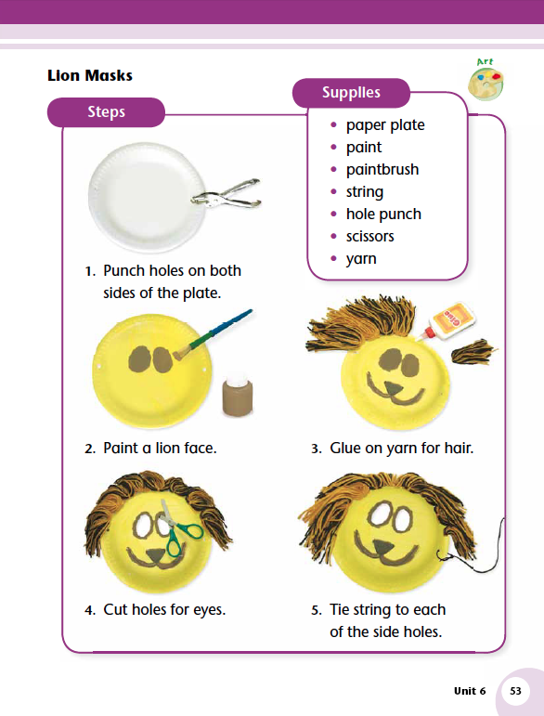
Let’s Look at the Program

Slide 12
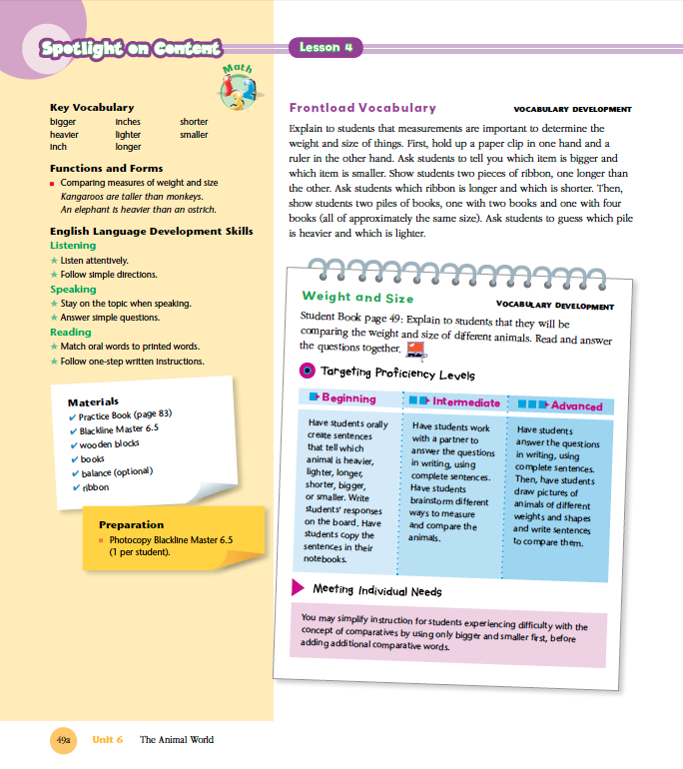
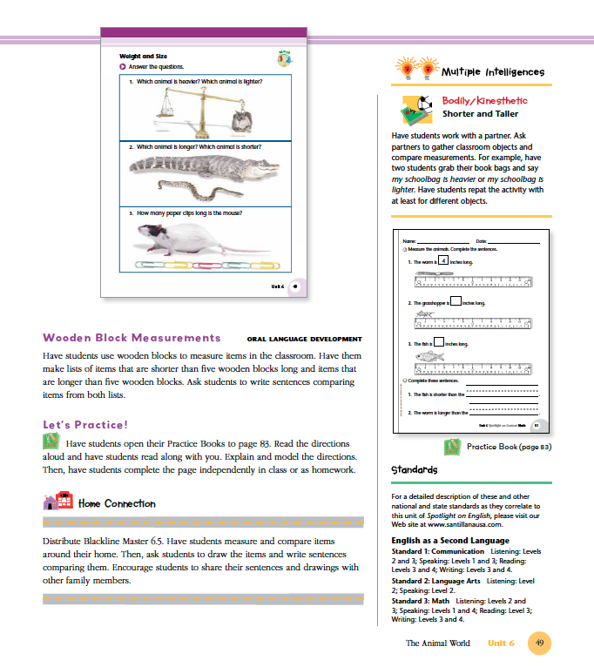
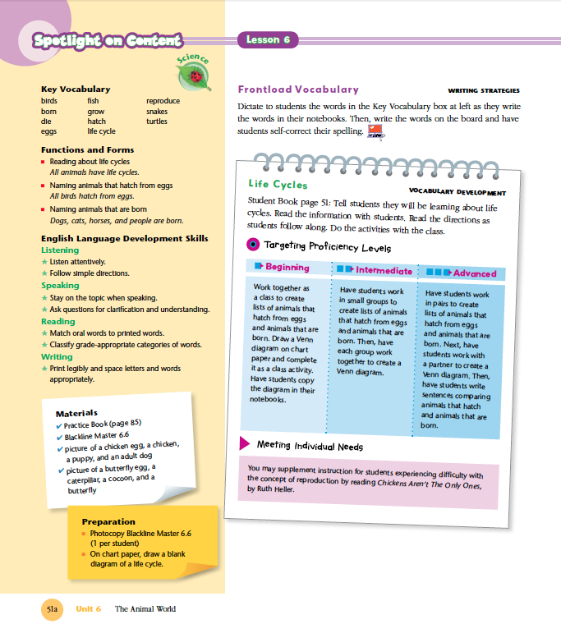
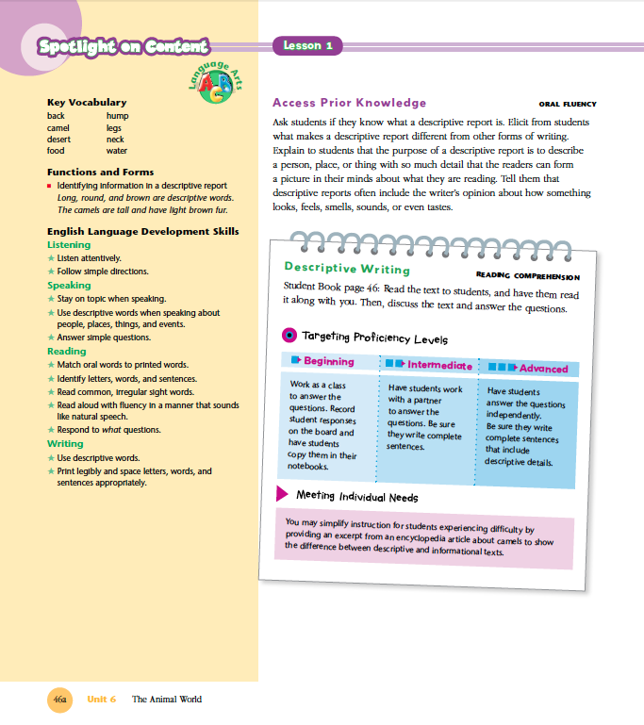
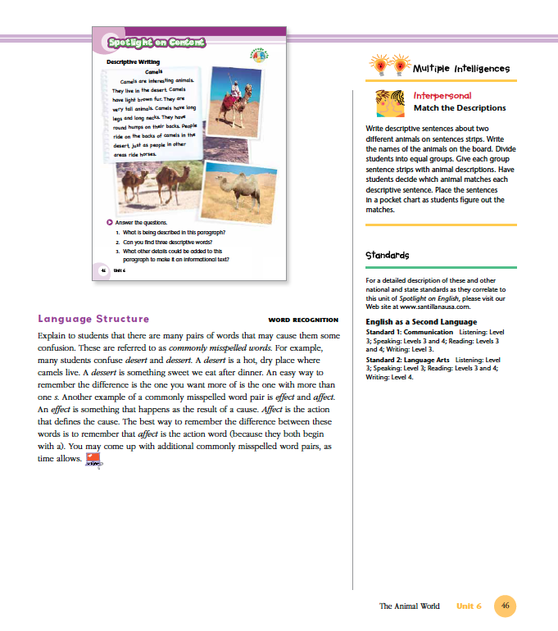
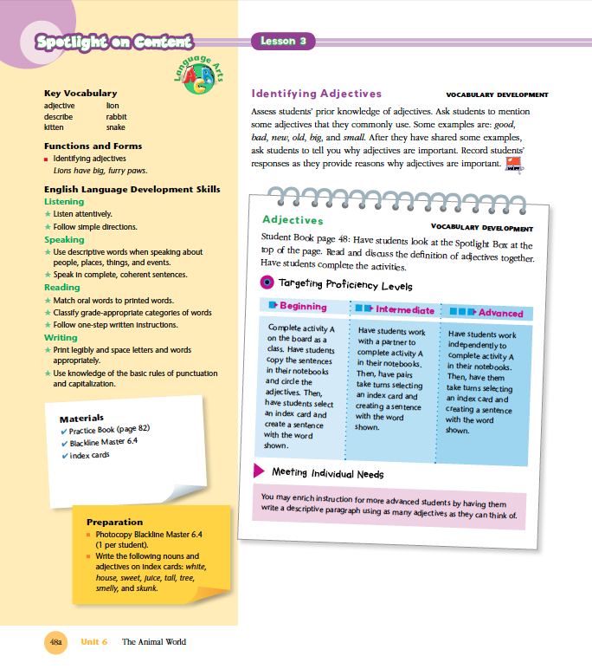
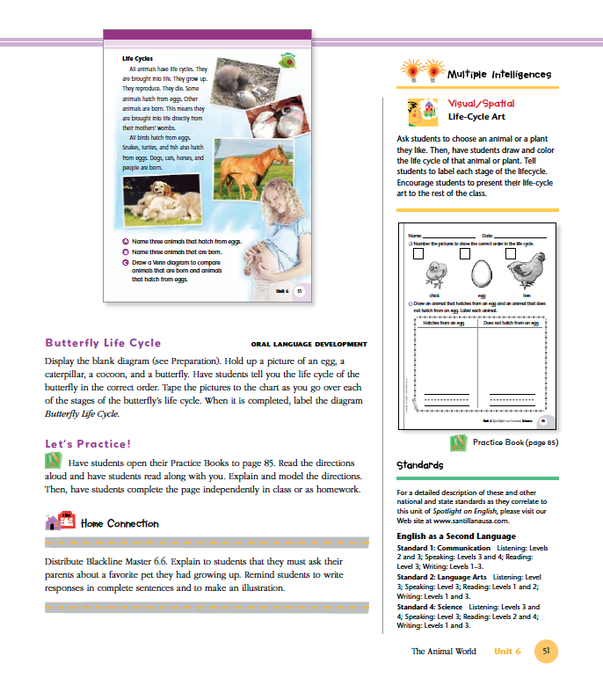
Let’s Look at the Teacher’s Guide

Slide 13
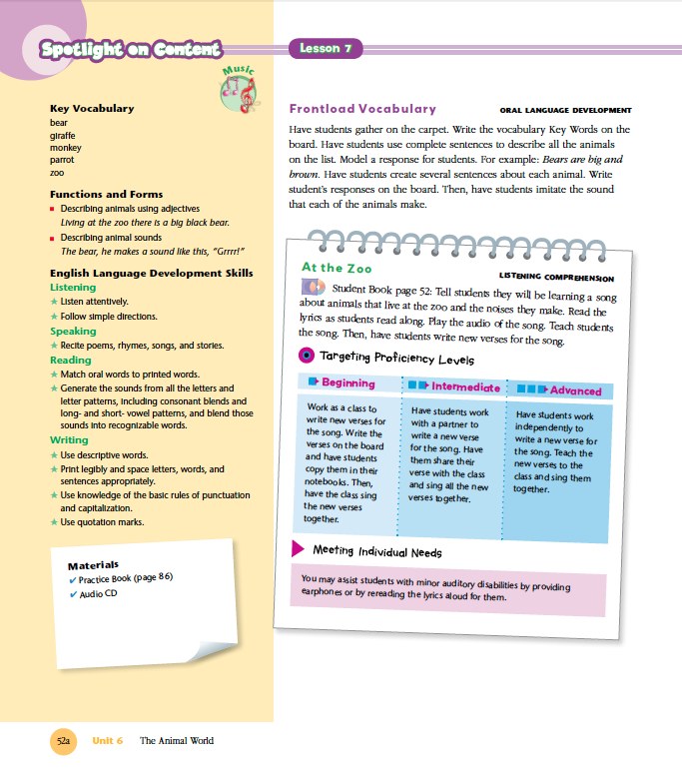
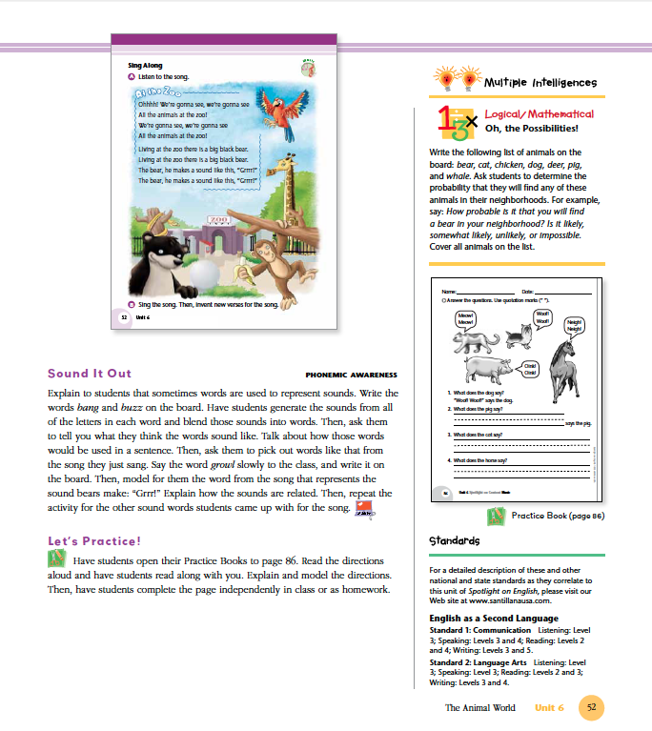
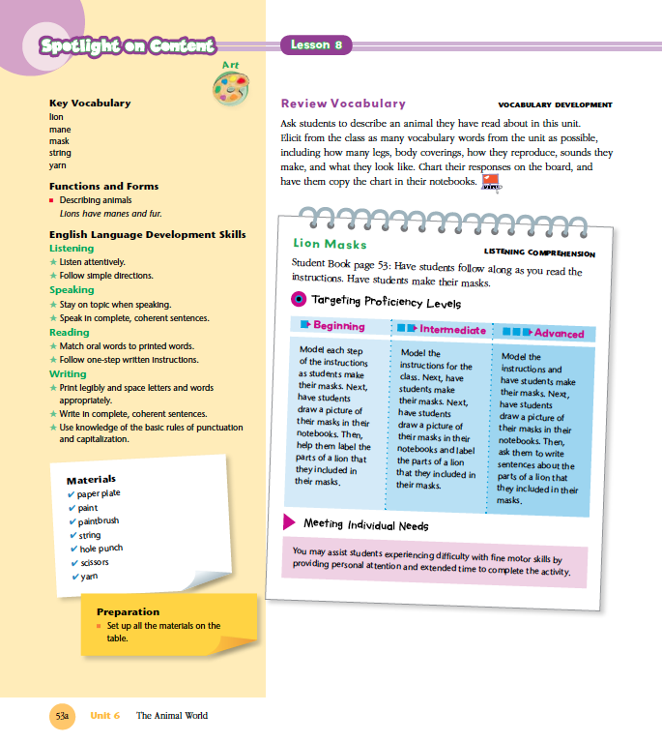
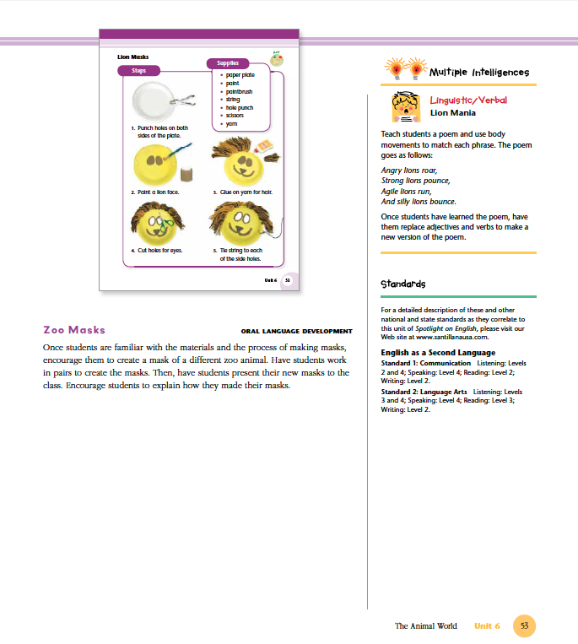
Let’s Look at the Program

Slide 14
Review of the Benefits of SOC
Supports content as well as literacy instruction, providing for the practice of both Academic vocabulary and domain-specific vocabulary.
Enables students to practice reading grade-level appropriate informational texts with increasing complexity, aided by appropriate scaffolding activities (CCSS’s staircase to complexity).

Slide 15
Review of the Benefits of SOC
Provides excellent opportunities for students to practice the English language accurately and within the norms and conventions of specific content areas.
Allows teachers to manage their ESL/ELD time in an easy and efficient manner, providing students with the rigorous reading practice they need, as well as engagement in and reinforcement of content-area concepts, vocabulary, and structures.

Slide 16
Review of the Benefits of SOC

Slide 17
Spotlight on Contents Price
Great news! We are pleased to announced that the price for Spotlight on Content has been reduced in an effort to reach more schools in the ESL/ELD market.
New price $24.95!

Slide 18
Additional Support for ESL/ELD

Slide 19
Additional Support for ESL/ELD

Slide 20
Additional Support for ESL/ELD

